Slide 1
DECODING GAMING BEHAVIOR
BY: DHIVYA. V

Slide 2
INTRODUCTION
Decoding gaming behavior involves understanding the motivations, preferences, and patterns exhibited by individuals while engaging in gaming activities. Gaming behavior analysis encompasses various aspects, including player psychology, gameplay mechanics, social interactions, and game design elements. By decoding gaming behavior, researchers, game developers, and marketers seek to gain insights into player preferences, motivations, and decision-making processes within gaming environments.

Slide 3
TABLES
Player Details Table:
Description of each column (P_ID, PName, L1_status, L2_status, L1_code, L2_code).
Level Details Table:
Description of each column (P_ID, Dev_ID, start_time, stages_crossed, level, difficulty, kill_count, headshots_count, score, lives_earned).

Slide 4
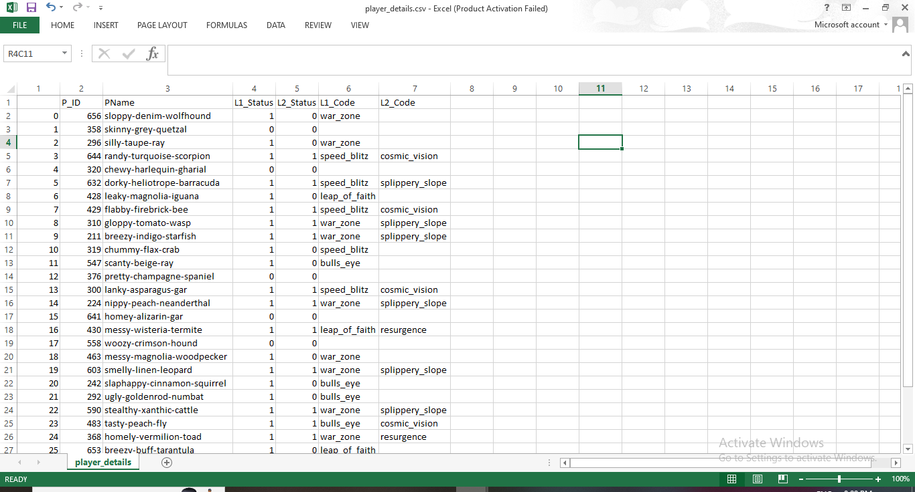
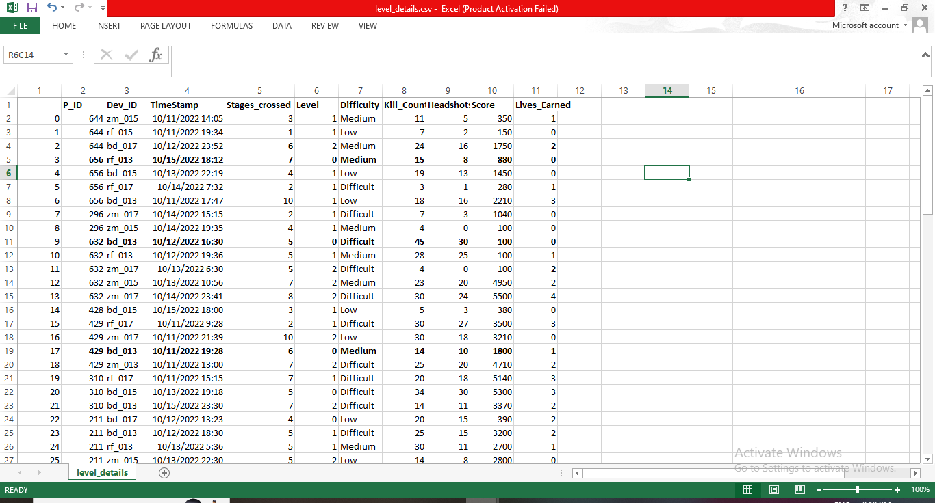
DATA DESCRIPTION
Explanation of key terms and concepts in the dataset (e.g., level, difficulty, kill count).
Overview of the relationships between the Player Details and Level Details tables.
Discussion on how the data can be used to analyze gaming behavior.

Slide 5
STEPS INVOLVED
Step 1 Title
SQL Queries
Step 2 Title
TOOL : MySQL
Step 3 Title
Database

Slide 6
TOOL USED : MySQL
MySQL's relational database model is well-suited for storing structured gaming data, such as player details and game levels, in a systematic and organized manner.
SQL queries can be used to extract, analyze, and manipulate gaming data stored in MySQL databases, facilitating data analysis and insights generation.
MySQL's scalability allows for the storage and management of large volumes of gaming data, accommodating the requirements of diverse gaming projects and applications.
Security features provided by MySQL ensure the confidentiality, integrity, and availability of gaming data, safeguarding it from unauthorized access and data breaches.

Slide 7
CREATE DATABASE
DISPLAY TABLE
CREATE DATABASE GAME_ANALYSIS
USE GAME_ANALYSIS;
SELECT * FROM player_details;
SELECT * FROM level_details;
ALTER TABLE
alter table player_details modify L1_Status varchar(30);
alter table player_details modify L2_Status varchar(30);
alter table player_details modify P_ID int primary key;
alter table player_details drop myunknowncolumn;
alter table level_details drop myunknowncolumn;
alter table level_details change timestamp start_datetime datetime;
alter table level_details modify Dev_Id varchar(10);
alter table level_details modify Difficulty varchar(15);
alter table level_details add primary key(P_ID,Dev_id,start_datetime);

Slide 8
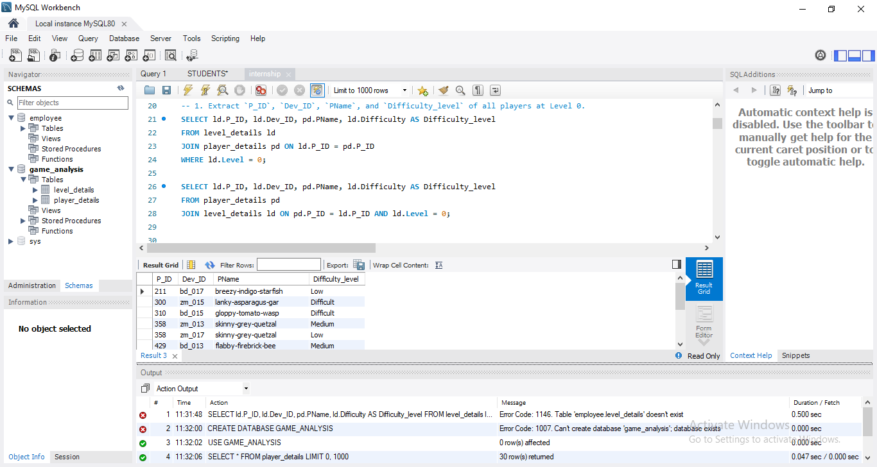
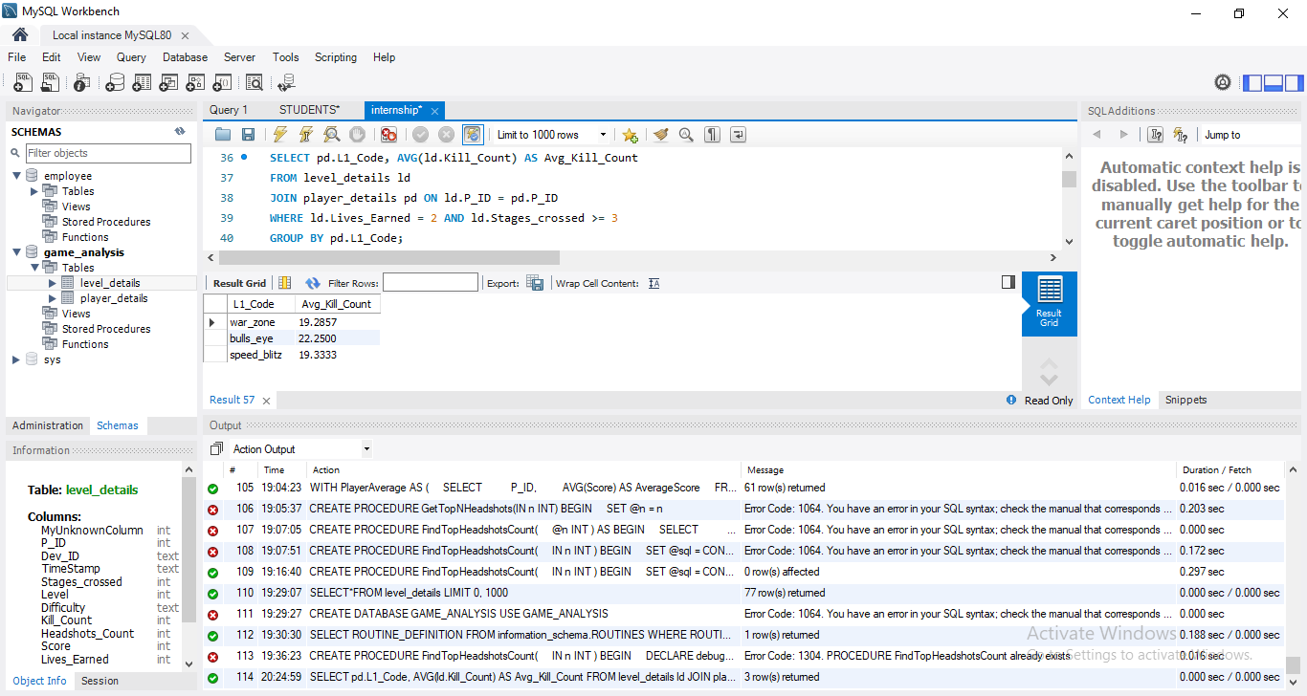
1. Extract `P_ID`, `Dev_ID`, `PName`, and `Difficulty_level` of all players at Level 0.
SELECT ld.P_ID, ld.Dev_ID, pd.PName, ld.Difficulty AS Difficulty_level FROM level_details ld
JOIN player_details pd ON ld.P_ID = pd.P_ID
WHERE ld.Level = 0;
2. Find `Level1_code`wise average `Kill_Count` where `lives_earned` is 2, and at least 3
stages are crossed.
SELECT pd.L1_Code, AVG(ld.Kill_Count) AS Avg_Kill_Count FROM level_details ld
JOIN player_details pd ON ld.P_ID = pd.P_IDWHERE ld.Lives_Earned = 2 AND ld.Stages_crossed >= 3
GROUP BY pd.L1_Code;

Slide 9
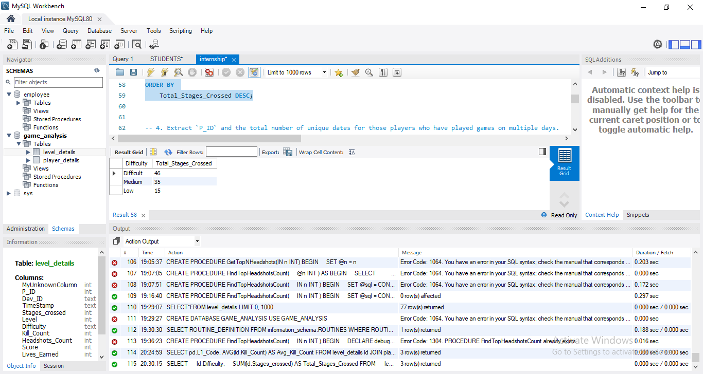
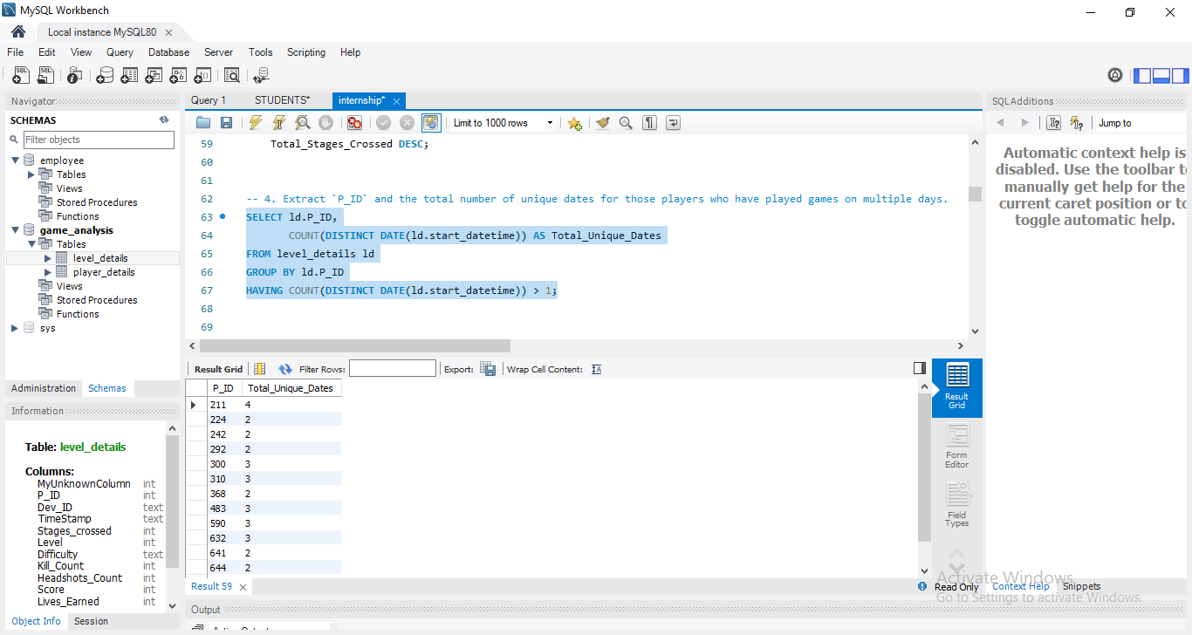
3. Find the total number of stages crossed at each difficulty level for Level 2 with players
using `zm_series` devices. Arrange the result in decreasing order of the total number of
stages crossed.
SELECT ld.Difficulty, SUM(ld.Stages_crossed) AS Total_Stages_Crossed
FROM level_details ld JOIN player_details pd ON ld.P_ID = pd.P_ID
WHERE ld.Level = 2 AND ld.Dev_ID LIKE 'zm_%‘
GROUP BY ld.Difficulty ORDER BY Total_Stages_Crossed DESC;
4. Extract `P_ID` and the total number of unique dates for those players who have played
games on multiple days.
SELECT ld.P_ID,
COUNT(DISTINCT DATE (ld.start_datetime)) AS Total_Unique_Dates FROM level_details ld GROUP BY ld.P_ID
HAVING COUNT(DISTINCT DATE(ld.start_datetime)) > 1;

Slide 10
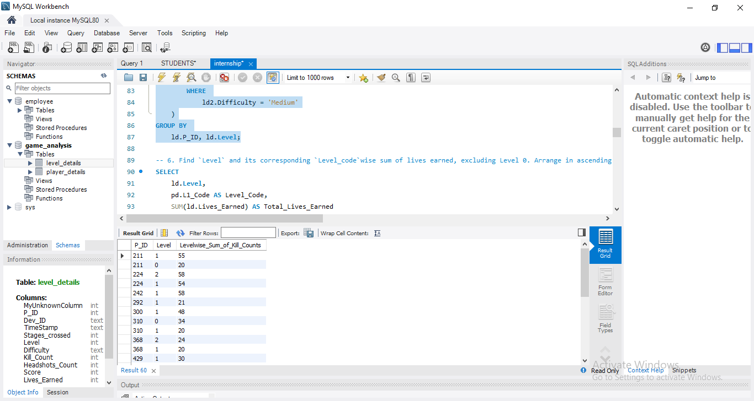
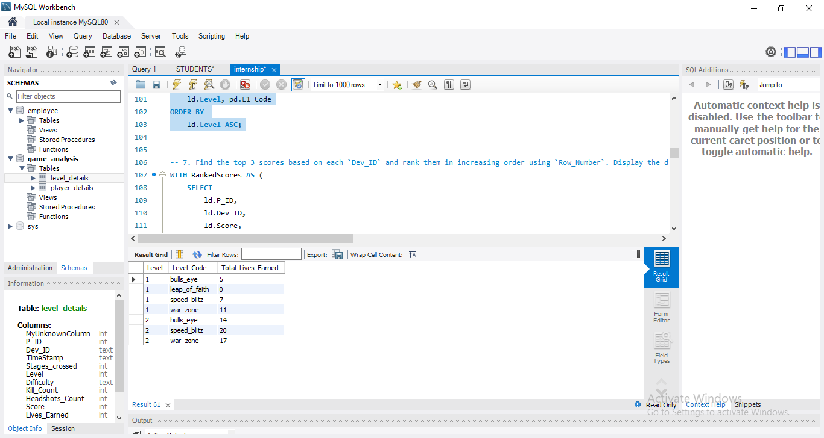
5. Find `P_ID` and levelwise sum of `kill_counts` where `kill_count` is greater than the
average kill count for Medium difficulty.
SELECT ld.P_ID, ld.Level, SUM(ld.Kill_Count) AS Levelwise_Sum_of_Kill_Counts
FROM level_details ld WHERE ld.Kill_Count > ( SELECT AVG(ld2.Kill_Count) FROM level_details ld2 WHERE ld2.Difficulty = 'Medium' )
GROUP BY ld.P_ID, ld.Level;
6. Find `Level` and its corresponding `Level_code`wise sum of lives earned, excluding Level 0. Arrange in ascending order of level.
SELECT ld.Level, pd.L1_Code AS Level_Code, SUM(ld.Lives_Earned) AS Total_Lives_Earned FROM level_details ld JOIN player_details pd ON ld.P_ID = pd.P_ID WHERE ld.Level > 0 GROUP BY ld.Level, pd.L1_Code ORDER BY ld.Level ASC;

Slide 11
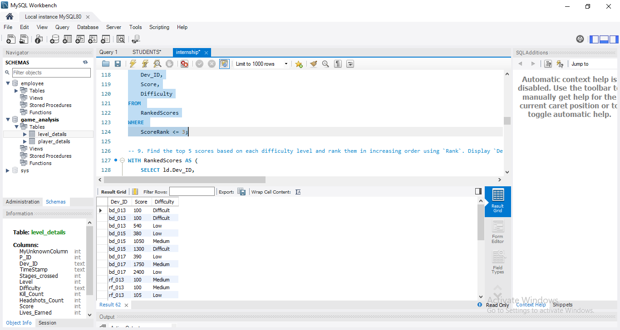
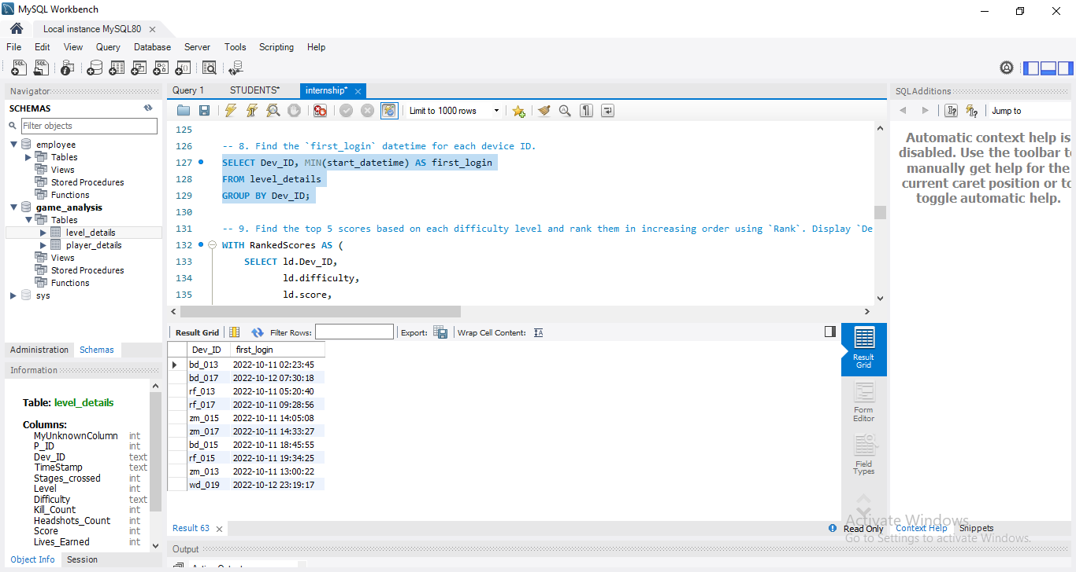
7. Find the top 3 scores based on each `Dev_ID` and rank them in increasing order using
`Row_Number`. Display the difficulty as well.
WITH RankedScores AS (SELECT ld.P_ID, ld.Dev_ID, ld.Score, ld.Difficulty, ROW_NUMBER() OVER (PARTITION BY ld.Dev_ID ORDER BY ld.Score ASC) AS ScoreRank FROM level_details ld) SELECT Dev_ID, Score, Difficulty
FROM RankedScores WHERE ScoreRank <= 3;
8. Find the `first_login` datetime for each device ID.
SELECT Dev_ID, MIN(start_datetime) AS first_login
FROM level_details
GROUP BY Dev_ID;

Slide 12
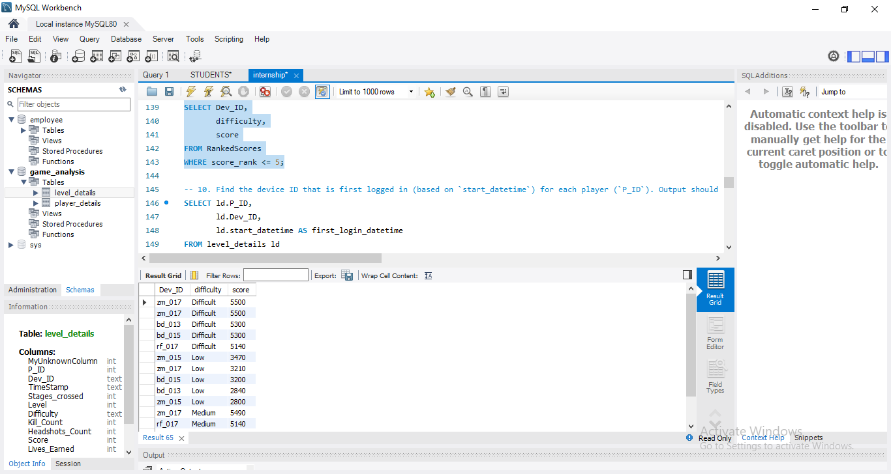
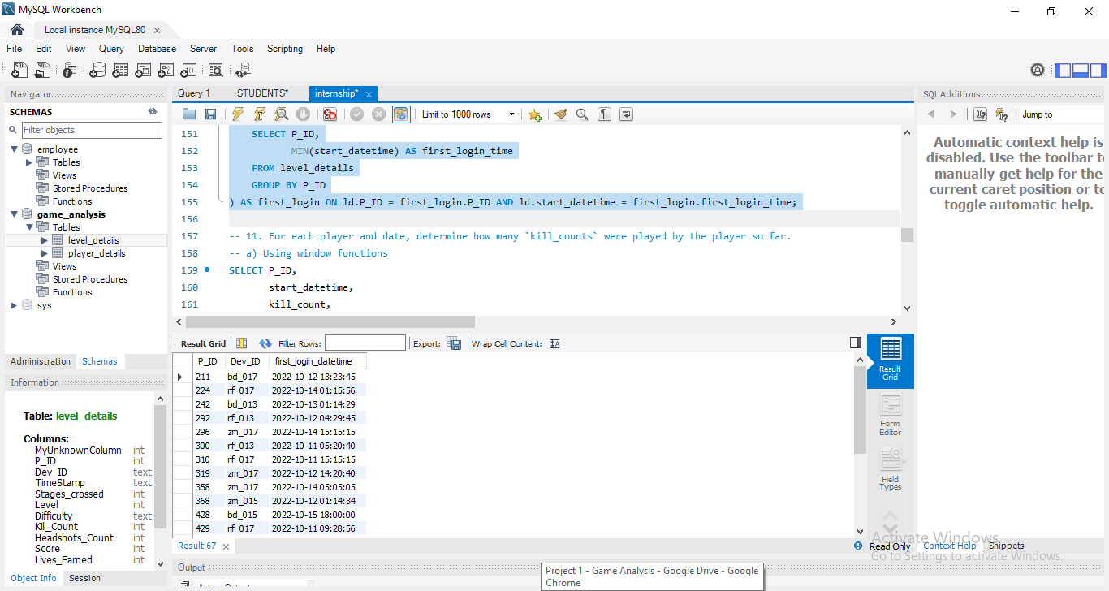
9. Find the top 5 scores based on each difficulty level and rank them in increasing order
using `Rank`. Display `Dev_ID` as well.
WITH RankedScores AS ( SELECT ld.Dev_ID, ld.difficulty, ld.score, RANK() OVER (PARTITION BY ld.difficulty ORDER BY ld.score DESC) AS score_rank
FROM level_details ld) SELECT Dev_ID, difficulty, score
FROM RankedScores WHERE score_rank <= 5;
10. Find the device ID that is first logged in (based on `start_datetime`) for each player
(`P_ID`). Output should contain player ID, device ID, and first login datetime.
SELECT ld.P_ID, ld.Dev_ID, ld.start_datetime AS first_login_datetime
FROM level_details ld JOIN (SELECT P_ID, MIN(start_datetime) AS first_login_time
FROM level_details GROUP BY P_ID)
AS first_login ON ld.P_ID = first_login.P_ID AND ld.start_datetime = first_login.first_login_time;

Slide 13
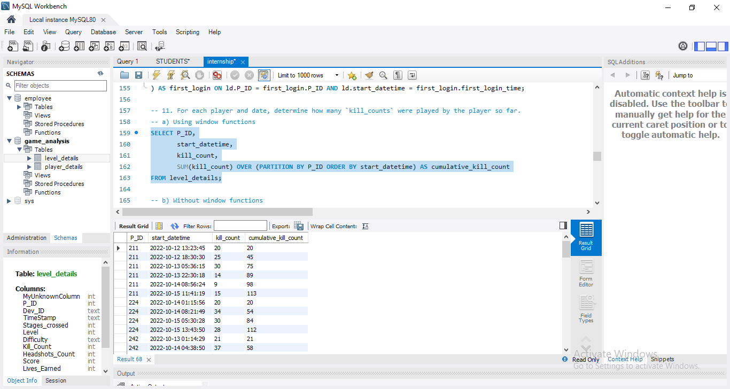
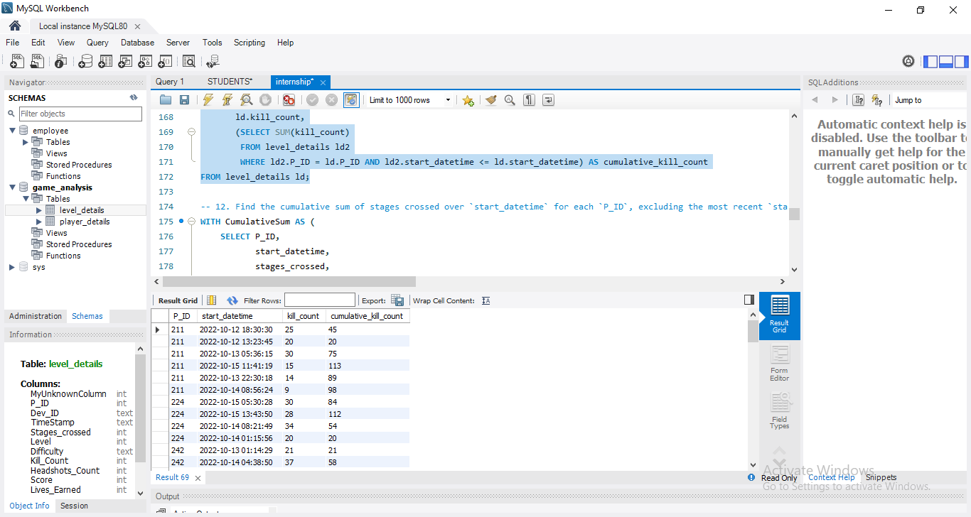
11. For each player and date, determine how many `kill_counts` were played by the player
so far.
a) Using window functions
SELECT P_ID, start_datetime, kill_count, SUM(kill_count) OVER (PARTITION BY P_ID ORDER BY start_datetime) AS cumulative_kill_count
FROM level_details;
b) Without window functions
SELECT ld.P_ID, ld.start_datetime, ld.kill_count, (SELECT SUM(kill_count) FROM level_details ld2
WHERE ld2.P_ID = ld.P_ID AND ld2.start_datetime <= ld.start_datetime) AS cumulative_kill_countFROM level_details ld;

Slide 14
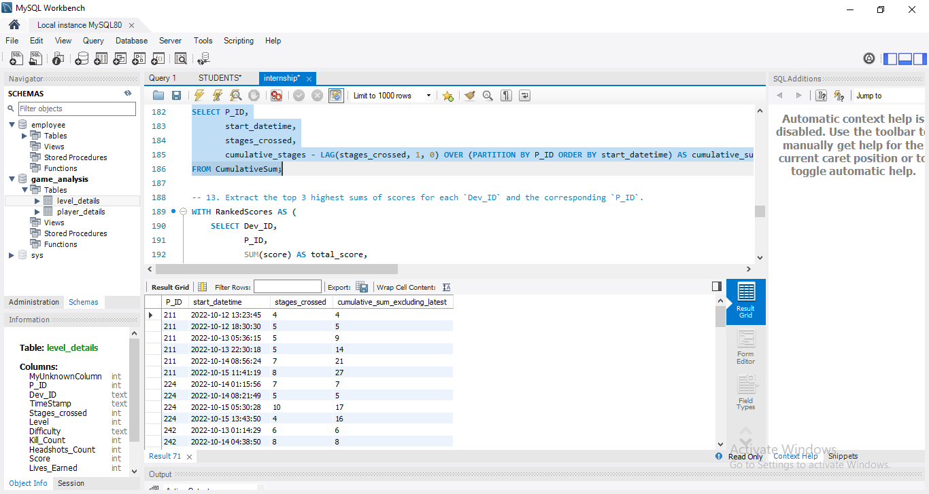
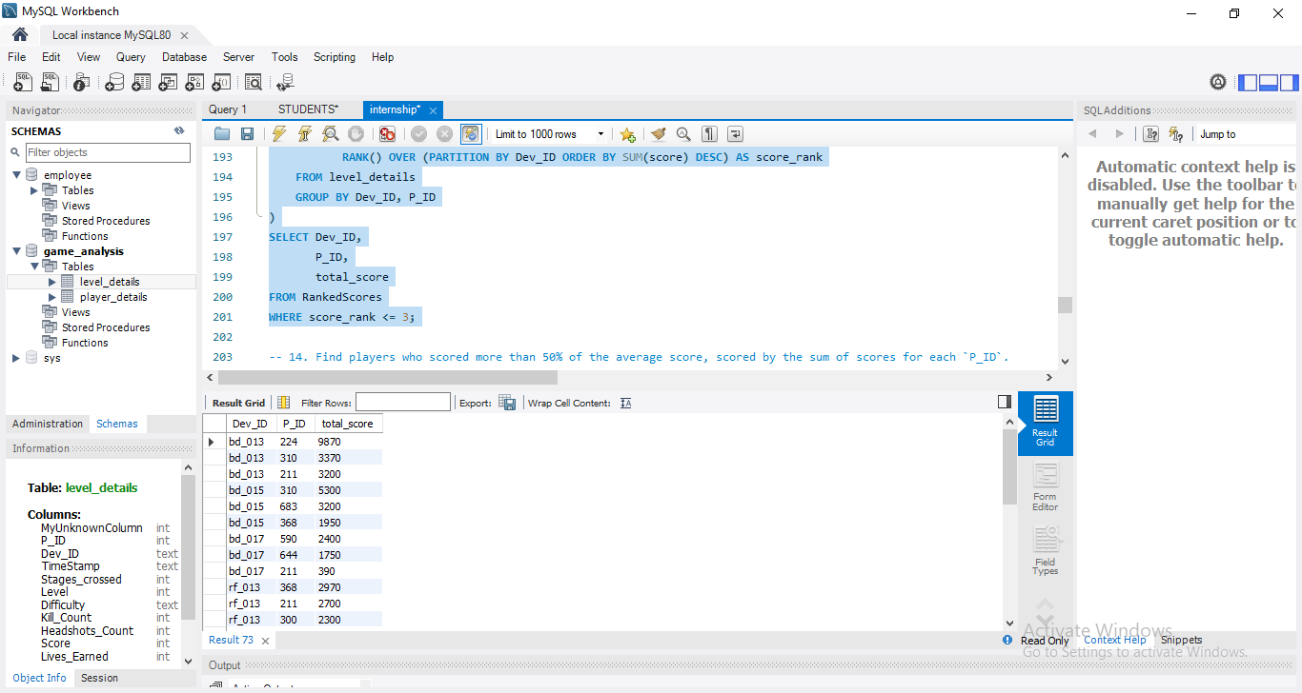
12. Find the cumulative sum of stages crossed over `start_datetime` for each `P_ID`,
excluding the most recent `start_datetime`.
WITH CumulativeSum AS (SELECT P_ID, start_datetime, stages_crossed, SUM(stages_crossed) OVER (PARTITION BY P_ID ORDER BY start_datetime) AS cumulative_stages FROM level_details) SELECT P_ID, start_datetime, stages_crossed, cumulative_stages - LAG(stages_crossed, 1, 0) OVER (PARTITION BY P_ID ORDER BY start_datetime) AS cumulative_sum_excluding_latest
FROM CumulativeSum;
13. Extract the top 3 highest sums of scores for each `Dev_ID` and the corresponding `P_ID`.
WITH RankedScores AS ( SELECT Dev_ID, P_ID, SUM(score) AS total_score, RANK() OVER (PARTITION BY Dev_ID ORDER BY SUM(score) DESC) AS score_rank FROM level_details GROUP BY Dev_ID, P_ID)SELECT Dev_ID, P_ID, total_scoreFROM RankedScores
WHERE score_rank <= 3;

Slide 15
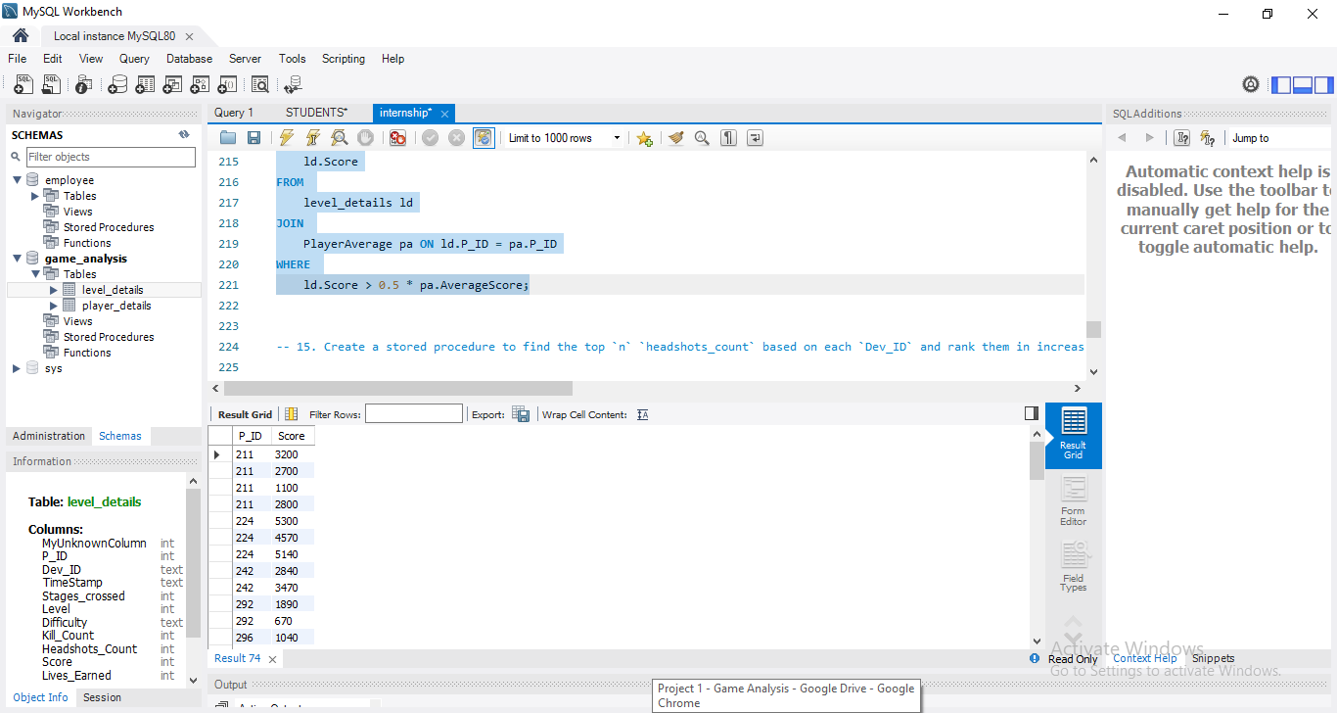
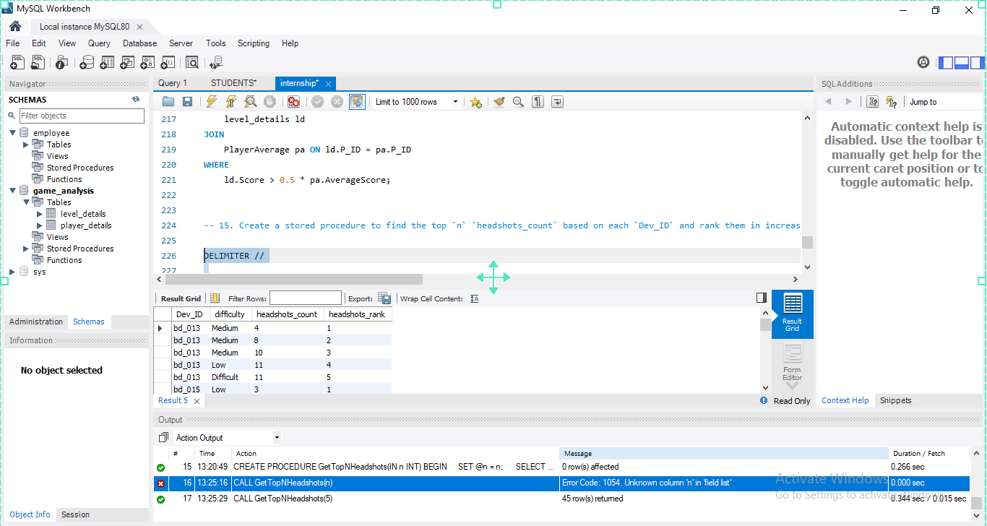
14. Find players who scored more than 50% of the average score, scored by the sum of
scores for each `P_ID`.
WITH PlayerAverage AS ( SELECT P_ID, AVG(Score) AS
FROM level_details GROUP BY P_ID)SELECT ld.P_ID, ld.Score
FROM level_details ld JOIN PlayerAverage pa ON ld.P_ID = pa.P_ID
WHERE ld.Score > 0.5 * pa.AverageScore;
15. Create a stored procedure to find the top `n` `headshots_count` based on each `Dev_ID`and rank them in increasing order using `Row_Number`. Display the difficulty as well.
DELIMITER //CREATE PROCEDURE GetTopNHeadshots(IN n INT)BEGIN SET @n = n; SELECT Dev_ID, difficulty, headshots_count, headshots_rank FROM (SELECT Dev_ID, difficulty, headshots_count, ROW_NUMBER() OVER (PARTITION BY Dev_ID ORDER BY headshots_count ASC) AS headshots_rank FROM level_details ) AS ranked_headshots
WHERE headshots_rank <= @n;END //DELIMITER ;
CALL GetTopNHeadshots(5);

Slide 16
FUTURE OUTCOME
1. Precision Personalization: Tailoring gaming experiences to individual preferences and emotional responses through advanced AI and player analytics.
2. Enhanced Immersion: Utilizing VR, AR, and immersive technologies to engage players on deeper emotional, cognitive, and physiological levels.
3. Ethical Design and Regulation: Developing ethical design principles and regulatory frameworks to promote player well-being and mitigate potential harms.
4. Cross-Disciplinary Insights: Fostering collaboration across psychology, neuroscience, sociology, and anthropology for deeper understandings of gaming behavior.
5. Positive Social Impact: Harnessing gaming for education, healthcare, and social change, fostering empathy, understanding, and societal progress.

Slide 17
CONCLUSION
In conclusion, understanding gaming behavior is crucial for creating better gaming experiences. By analyzing player data, we've learned about player preferences and patterns.
The dataset has given us insights into which game levels and difficulties players prefer. This information can help improve game design to better meet player needs.
Looking ahead, this project's findings will lead to more engaging games and smarter marketing strategies. By knowing what players want, we can create games that players love and market them more effectively.

Slide 18
Certainly! Here's a detailed content for the introduction and purpose of the analysis for your presentation on "Car Crash Analysis in Chicago":
**Introduction to the Presentation:**
Good morning/afternoon/evening, ladies and gentlemen.
I am pleased to welcome you to today's presentation on "Car Crash Analysis in Chicago." In today's session, we will delve into a comprehensive analysis of car crash data in Chicago, utilizing powerful data visualization tools to uncover insights that are crucial for enhancing road safety and traffic management in our city.
**Brief Overview of the Importance of Road Safety:**
Before we delve into the specifics of our analysis, let's take a moment to reflect on the paramount importance of road safety. Every year, thousands of lives are tragically lost, and countless more are affected by road accidents. Ensuring the safety of our roads is not just a moral imperative but also an economic necessity. Road accidents result in significant economic losses, strain healthcare systems, and have a profound impact on the well-being of individuals and communities.
**Purpose of the Analysis:**
The primary objective of our analysis is to gain a comprehensive understanding of car crash trends in Chicago and to identify areas for improvement in road safety measures. By leveraging data-driven insights, we aim to:
1. Identify patterns and trends in car crash incidents over time, including seasonal variations, peak hours, and geographic hotspots.
2. Explore the contributing factors to car crashes, such as weather conditions, road surface conditions, and traffic control devices.
3. Analyze the severity and distribution of injuries resulting from car crashes, with a focus on identifying high-risk groups and injury types.
4. Provide actionable recommendations for enhancing road safety measures and reducing the incidence of car crashes in Chicago.
Through our analysis, we seek to empower policymakers, law enforcement agencies, and other stakeholders with the insights needed to implement targeted interventions and initiatives that will make our roads safer for all.
Thank you for joining us today as we embark on this journey to drive positive change and foster a culture of safety on Chicago's roads. Let's begin our exploration of car crash analysis in Chicago and work together towards building a safer, more resilient community.

Slide 19
THANK YOU

